Slide 1
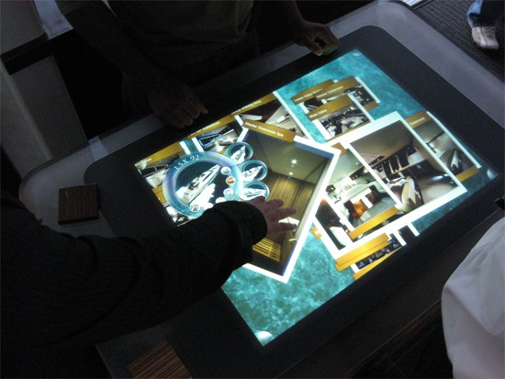
WONDERING WHAT THE FUTURE WOULD LOOK LIKE..??

Slide 2


SURFACE COMPUTER

Slide 3
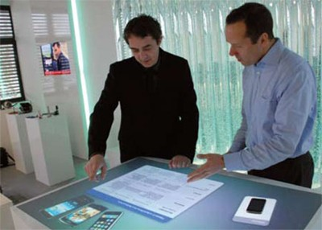
What are Surface computers???

Slide 4
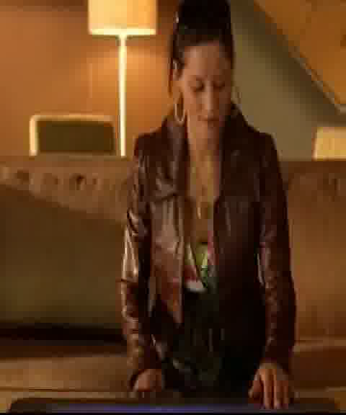

Slide 5
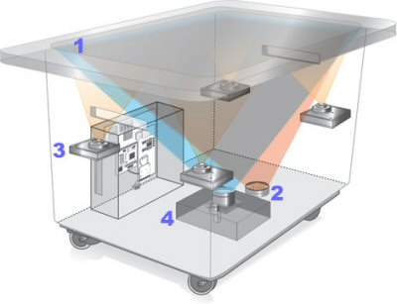
WORKING
1.SCREEN
2.INFRA RED
3.CPU
4.PROJECTOR

Slide 6

Direct interaction

Slide 7
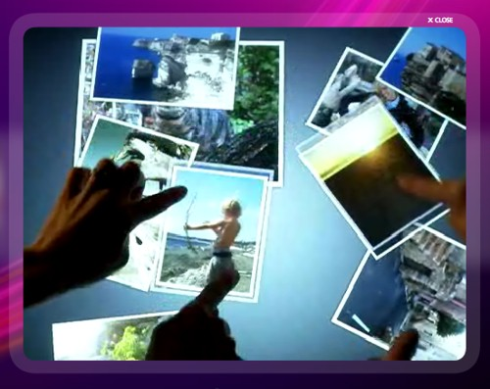
Multi-Input

Slide 8
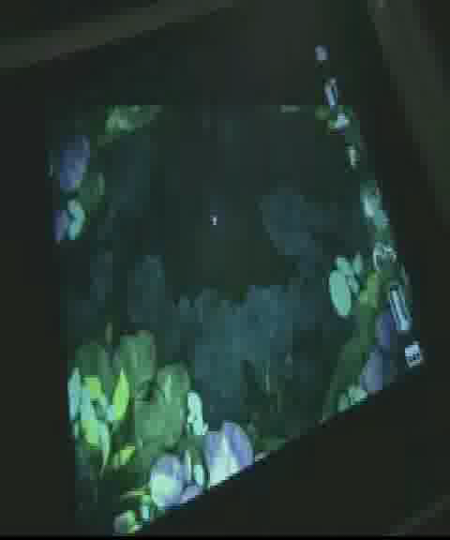

Slide 9
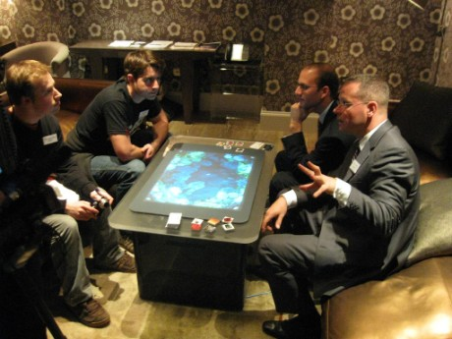
Multi-User

Slide 10
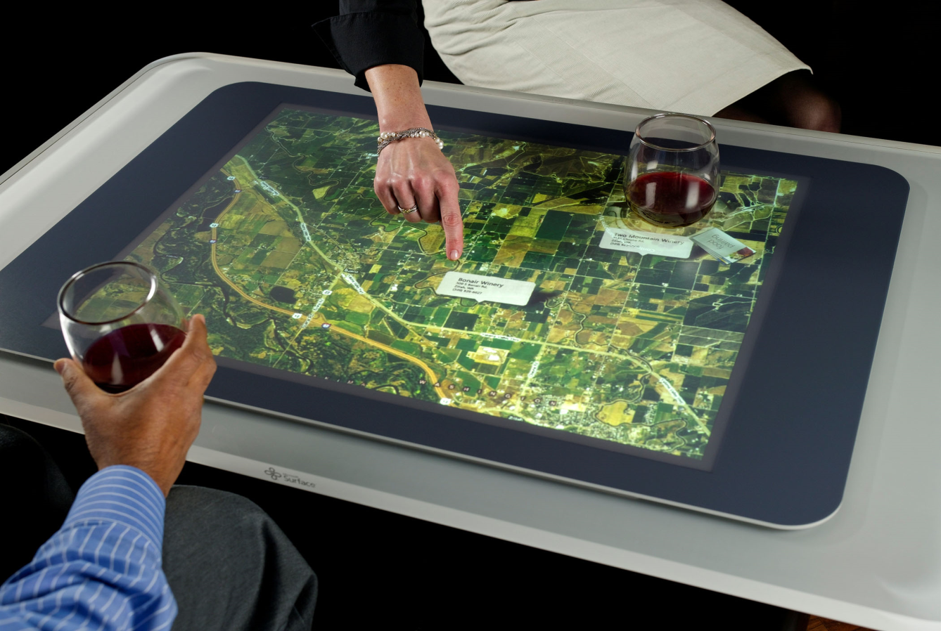
Object Recognition

Slide 11
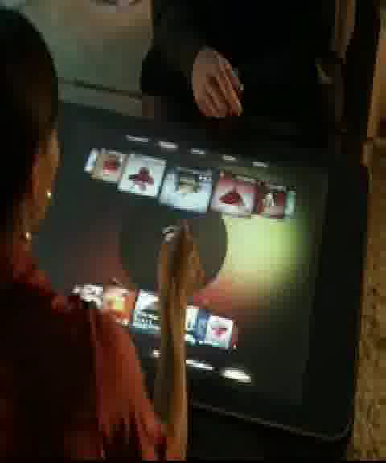

Slide 12
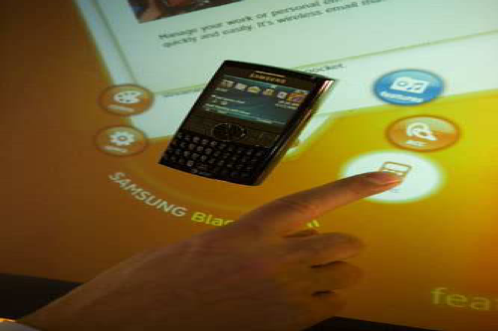
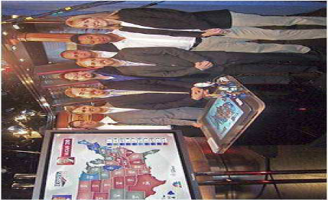

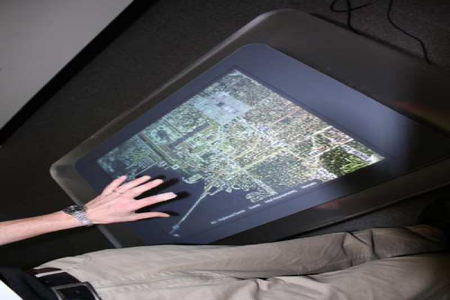
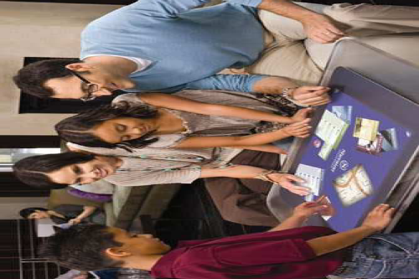
Surface in Action Today
Water resistant
Hard

Slide 13
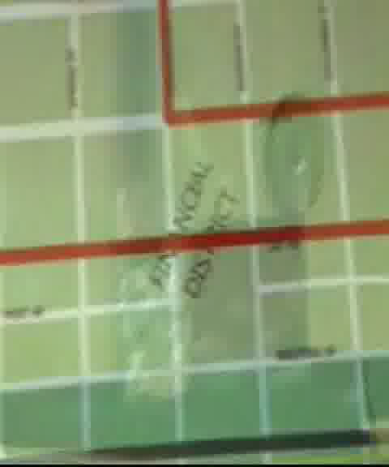

Slide 14


AFFECTS ON INDIAN LIVING
AFFECTS ON INDIAN LIVING
Tablet PC
Cost
Track-pad

Slide 15
THANK YOU

